Slide 1


Slide 2

Topics
What is CDN
What is CloudFront
CloudFront - Key Terminology
CloudFront and S3 Transfer Acceleration
Exam Tips

Slide 3
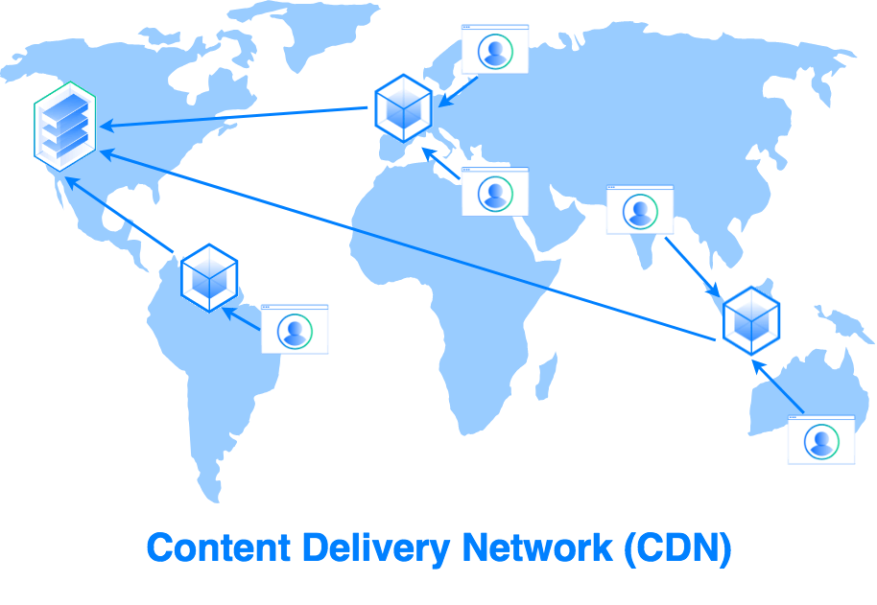
What is CDN?
A CDN or a content delivery network is a system of distributed servers (network) that deliver web pages and other web content to users based on the geographical location of the user, the origin of the web page and a content delivery server.

Slide 4
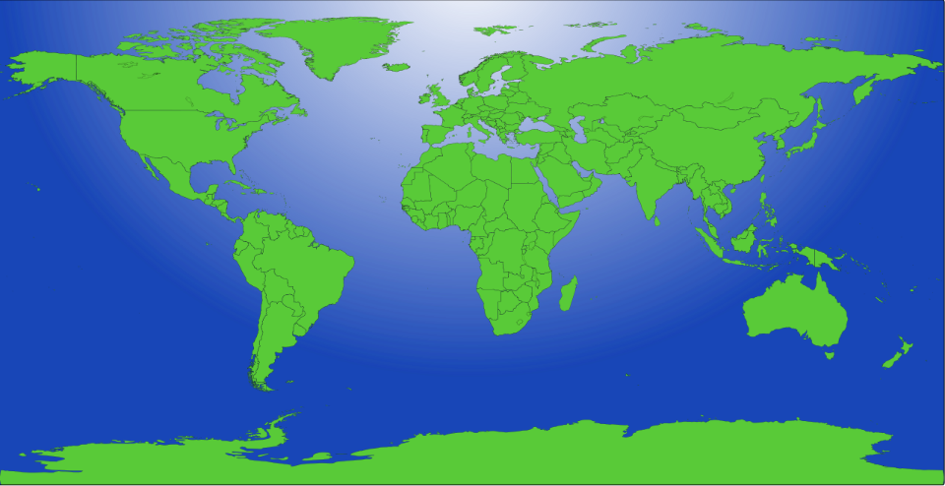


CDN

Slide 5

CDN

Slide 6

What is CloudFront?
Amazon CloudFront can be used to deliver your entire web site, including dynamic, static, streaming and interactive content using AWS global network of edge locations.
Requests for your content are automatically routed to your nearest edge location and content is delivered to you with the best possible performance.
Ex:- Can be be used to optimize performance for users accessing a website backed by S3.
Amazon CloudFront is optimized to work with other Amazon Web Services, like S3, Ec2 instance, Elastic load balance or route 53.
Amazon CloudFront also works seamlessly with any non AWS origins Server, which stores the original, definitive version of your files.

Slide 7






CloudFront - Key Terminology
Edge Location - This is the location where content is cached you that you're trying read and can also be written. Separate to an AWS region or availability zone.
Origin - This is just the origin of all the files that the content delivery network will distribute. Origin can be S3, EC2 instance, Elastic load balance or Route 53.
Distribution - This is the name given to content distribution network, which consists of a collection of edge locations
1. Web distribution : - Used for Web sites (HTTP/HTTPs)
2. RTMP (Realtime messaging protocol ): Used for streaming audio video, data over the Internet or Flash multimedia content. (Adobe Real Time Messaging Protocol)

Slide 8


CloudFront and S3 Transfer Acceleration:
Amazon S3 Transfer Acceleration enables fast, easy and secure transfers of your files over long distances between your end users and an S3 bucket.
Transfer Acceleration takes advantage of cloud front's globally distributed edge location.
As the data arrives at an Edge location, data is routed to S3 over an optimized network.

Slide 9
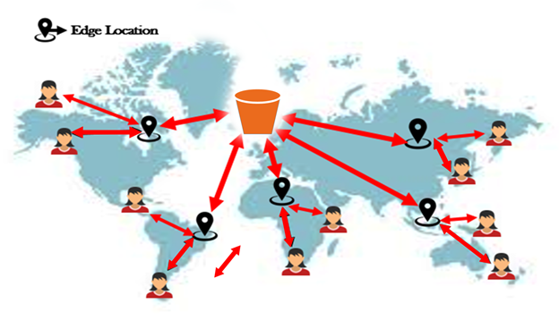
S3 Transfer Acceleration:
1 – End user to edge node
2 – Amazon Back bone N/W
2
1
1
2
2
2
2
1
1
1

Slide 10
Exam Tips:
Edge Location - This is the location where content is cached you can case content that you're trying and can also be written. Separate to an AWS region or availability zone.
Origin - This is just the origin of all the files that the content delivery network will distribute. Origin can be S3, EC2 instance, Elastic load balance or Route 53.
Distribution - This is the name given to content distribution network, which consists of a collection of edge locations
1. Web distribution : - Used for Web sites (HTTP/HTTPs)
2. RTMP (Realtime messaging protocol ): Used for streaming audio video, data over the Internet or Flash multimedia content. (Adobe Real Time Messaging Protocol)

Slide 11
Exam Tips:
Edge locations are not just read only - you can WRITE them too. (i.e. PUT an object on to them)
CloudFront edge Location are utilized by S3 transfer acceleration to reduce latency for S3 uploads.
Objects are cached for the life of the TTL (Time to Live)
You can clear cached objects, but you will be charged.

Slide 12
Thank you

